Slide 1
Introduction to Unit Testing
Using Junit and Mockito

Slide 2
Outlines
What? Why? Who?
Some terms to remember
Unit testing in eXtreme programming
JUnit
JUnit Annotations
Assertion
Naming convention
Hands on…
Test-driven Development

Slide 3
What?
Unit Testing:
Is a method of testing the correctness of a particular module of source code [WikiPedia]
Is testing of individual hardware or software units or groups of related units [IEEE90]
Is not to test high-level application functionality.

Slide 4
Why?
Reduce bugs in new features as well as existing features
Reduce cost of change
Guard against ripple effects of changes
Encourage refactoring
A firewall against other programmers
A way of documenting code
Forces you to take time to think
Slower start, faster completion
Enables automating engineering process

Slide 5
Who?
Unit tests cannot be written by a non-programmers
Back-end programmers
Data layer
Service layer
Front-end programmers
Interface functions
Interactions with back-end
UI/UX designer
Styling
Layout
View

Slide 6
Some Terms to Remember
Unit Testing: testing a unit of code extensively in all possible ways.
Refactoring: the practice of restructuring existing code for simplicity and clarity, without changing its behavior.
Regression Testing: retesting the software exhaustively to make sure that any changes have not broken the system.
Automated Testing: allows software to be tested as and when changes are made.
Acceptance Testing: testing high-level functions. These are designed by people who understand the business problem.
Performance Testing: the process of testing the speed, responsiveness and stability under a workload.
Stress Testing: the process of testing the robustness of software beyond the limits of normal operation (also covers load testing).

Slide 7
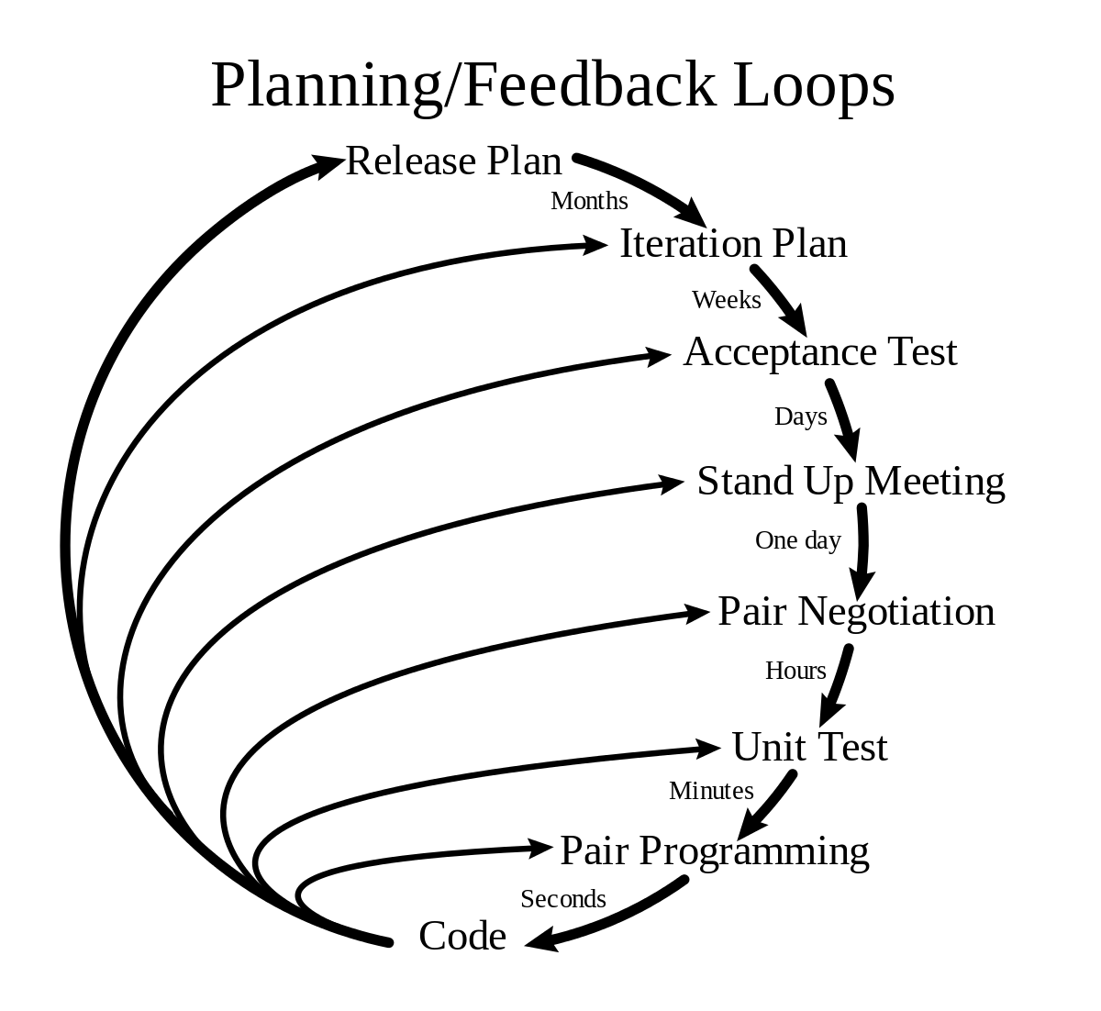
Unit Testing in eXtreme Programming
Use a framework
Test all modules/classes
Create test before actual functions
Change code only when a test fails
Tests embedded with source code
All tests should pass before packaging
Zero bug policy
XP/Agile development cannot be done without Unit Testing
Ref: http://www.extremeprogramming.org/rules/unittests.html

Slide 8
JUnit
JUnit is a Java framework for Regression testing
It allows creation and execution of unit tests
A test case is a Java class containing at least one test
A test is a public void method with no parameters
Tests are executed in a batch, independent of each other

Slide 9
JUnit Annotations
@BeforeClass
@AfterClass
@Before
@After
@Test, (expected=IOException.class), (timeout=10)
@Ignore
@RunWith(Suite.class, or else)
@SuiteClasses

Slide 10
Assertion
Assert class contains some static methods which assert whether given parameters are factual or not:
assertArrayEquals: states if two arrays are equal
assertEquals: states if the arguments are equal
assertFalse: states if the condition passed as argument is false
assertNotEquals: states if the arguments are not equal
assertNotNull: states if the argument is null
assertSame: states if arguments refer to same object
assertTrue: states if condition passed as argument is true
fail: fails a test

Slide 11
Naming Convention
There are no parameters, nor a return type
Comments are not very useful
Thus, the test name should say it all
Either start with “test…”, or “should…” or “shouldNot…”
It is accepted – helpful, in fact – to write a test name as: shouldNotThrowExceptionIfPropertiesFileDoesntExist()

Slide 12
Junit Installation
Maven
Gradle
<dependency>
<groupId>junit</groupId>
<artifactId>junit</artifactId>
<version>4.12</version>
</dependency>
apply plugin: 'java'
dependencies {
testImplementation 'junit:junit:4.12'
}
IntelliJ, Eclipse, Net Beans, all of these IDE’s have JUnit plugin built-in.

Slide 13
Hands on…
Fork the project on IHS GitLab in your own repository: https://git.ihsinformatics.com/owais.hussain/unit-testing-workshop
Check out your forked project
Import the project in your Java IDE
Run HelloUnitTest class as Junit Test
Explore the DateTimeUtil class; have a look at the way of testing the utility via main method
Now run the DateTimeUtilTest class as Junit Test

Slide 14
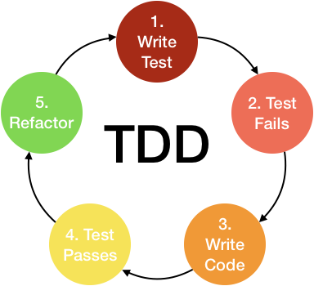
Test-driven Development
TDD revolves around one simple concept, i.e. to write test before the real code.
For new features, create stub code and write test cases first.
For changes, write test case to test the specific change first.
For bug fixes, recreate the bug in a new test case before fixing it.

Slide 15
SemVer: A case for TDD
Semantic versioning [https://semver.org] is most widely used scheme of incremental versioning.
We define a version in the following manners:
Pre-alpha (Dev): 0.0.#
Alpha (for Q/A): 0.#.#-alpha
Beta (for Q/A plus client): [last successful alpha version] -beta
First release: 1.0.0
Following releases: [MAJOR].[Minor].[micro]
Let’s write a SemVerUtil class in TDD way. Check the code stub for SemVerUtilTest class.

Slide 16
Checklist
There should be at least one test against every case.
There should ideally be single assert statement inside a test. A test will fail on first failed assertion, so no use of multiple asserts.
Expected Exceptions should be thrown (think how amusing it would be to fail a test in try and passing in catch block).
100% test coverage is a dilemma. Testing innocent constructors, getters/setters, overloaded wrapping methods, are a waste.
Test suite should be created for your own ease, not for the build management tool.
While writing test cases, focus only on testing, leave // TODO’s in the code or Tasks in IDE to make code amendments after test cases have all been written.
Test cases should not assume that any function in the actual code are correct.

Slide 17
Exercise 1
Complete the test cases for from/to SQL date methods in DateTimeUtilTest
Some tests are failing in this class. Find and fix the bug in DateTimeUtil class
Commit your code on GitLab (forked project)

